Slide 1
Baseball Salary SAS Project
Zachary Wing

Slide 2
Eliminate Blank Salary values
data newdata2;
set newdata (where=(Salary ne .));
run;
This shorted the data 322 to 263 observations

Slide 3
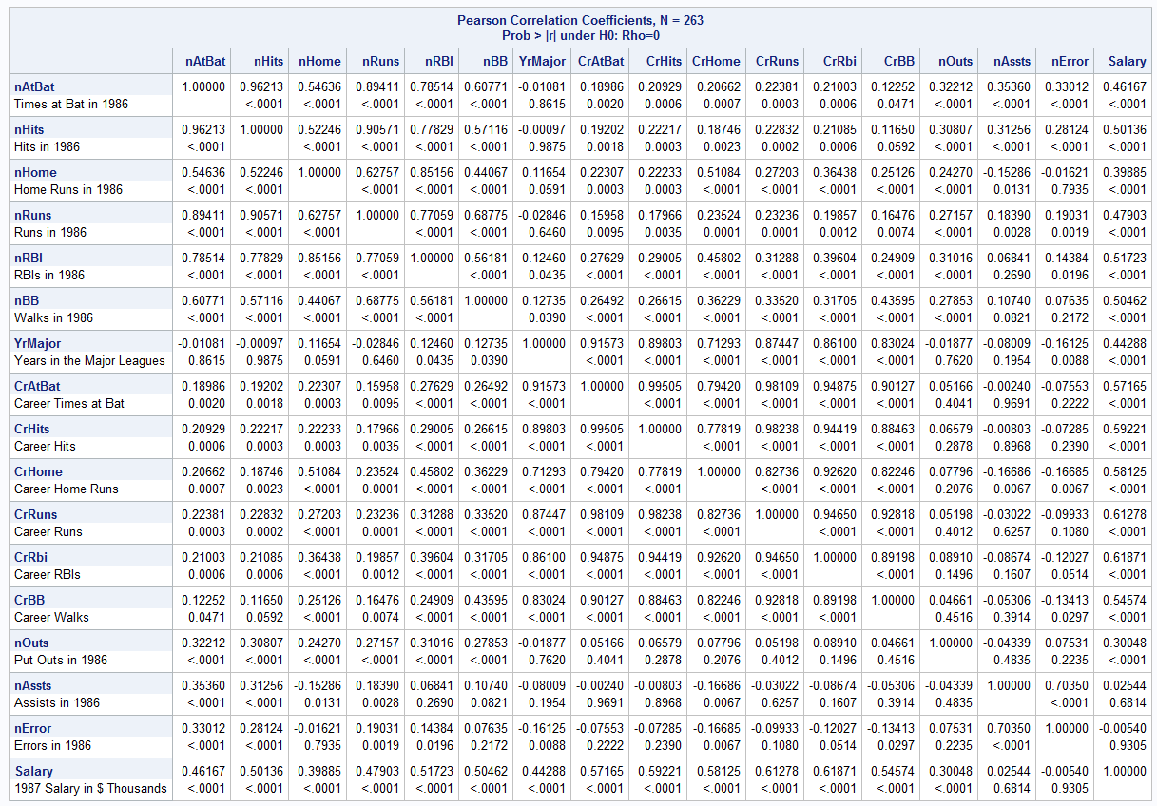
Examine the correlation structure of the continuous variables. What variables look like good predictors?
The Variables that seem to be the best predictors for salary are Career RBIs, Career Runs, Career Hits, Career At Bats, Career Walks, 1986 RBI, 1986 Walks, and 1986 Hits

Slide 4
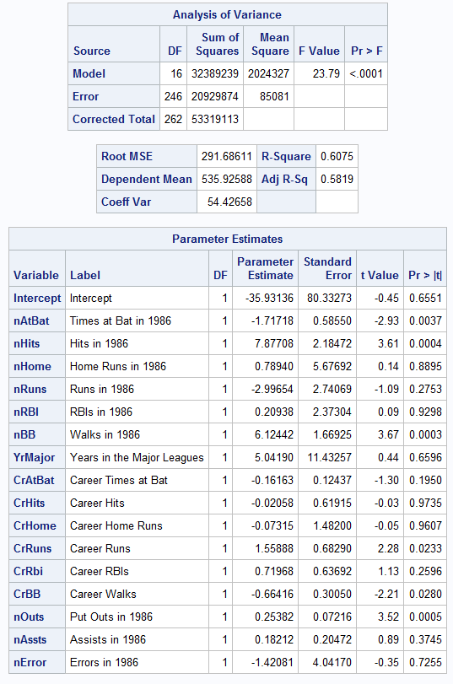
What are the F and adjusted R² values for this model? What do these values imply about the ability to predict in this case?
The F value is kind of low, enough where it is kind of significant but looking at the individual variables it can be increased if we get rid some. R square shows that the current model covers 60% of the variance which is ok but not the best

Slide 5
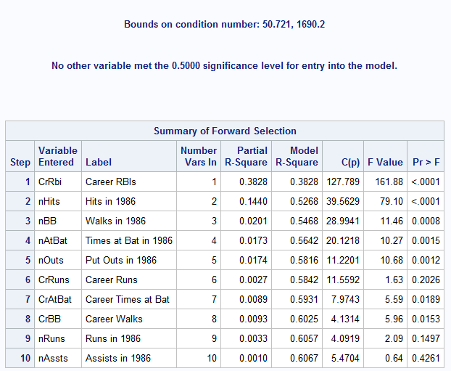
Run the model under FORWARD variable selection. What F and R² variables do you wind up with? What appear to be the best three predictors? Where is there the largest discrepancy between predicted salary and observed salary? What does this suggest about “super star” salaries?
Comparing this to my prediction Career Hits, and 1986 RBI did not make the list but 1986 At Bats, 1986 Outs, 1986 runs, and 1986 Assists made the list.
If you look at the list it shows the ones over F value of .5 significance but some p values are over .05 chance level
1986 Assists, 1986 Runs, Career Runs should not be on the list.
The 3 best are Career RBIs, 1986 Hits, 1986 Walks
People under $600,000 salary for the most part have a really higher predicted value than their salary (underpaid) and those that have an actual salary above $600,000 are actually above their predicted salary (overpaid)

Slide 6
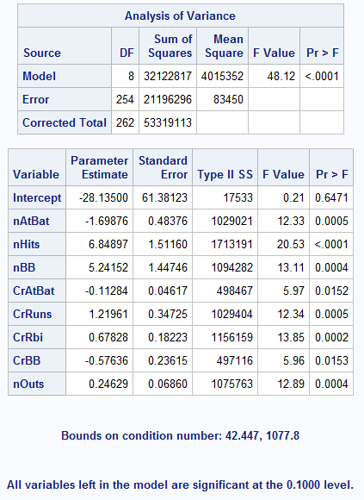
Run the model under REVERSE variable selection. What F and R² values do you get? How do they compare to the results in b and c? Under the reverse model what are the three best predictors? Where are the largest discrepancies between predicted and salary and observed salary?
Comparing this to my prediction Career Hits, and 1986 RBI did not make the list but, 1986 At Bats, 1986 Outs, made the list.
If you look at the list it shows the ones over F value of .1 significance and all p values are under .05 chance level
All of the ones on the list should be there
The 3 best are 1986 Hits, Career RBIs, 1986 walks
Still People under $600,000 salary for the most part have a really higher predicted value than their salary (underpaid) and those that have an actual salary above $600,000 are actually above their predicted salary (overpaid)

Slide 7
Create 3 new variables, the squared values of your best 3 predictors, and then build the regression model including these 3 new variables.
The 3 best predictors in both forward and backward are 1986 Hits, Career RBIs, and 1986 Walks

Slide 8
Show the kitchen sink result plus one selection method. Did this make a noticeable difference in performance?
Original
F=23.79
R Square=.6075
3 Best
F=104.18
R Square=.5468
3 Best Square
F=80.42
R Square=.4823
The best model is to just include the three best predictors against salary it has the highest F score way more than the original and the square method and has a higher R square than the square method as well.

